Slide 1
Steel Production Overview

Slide 2

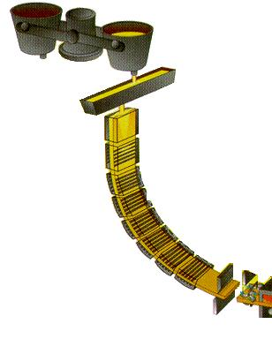

CONTINUOUS CASTING PROCESS
Ladle
MOLTEN STEEL BROUGHT IN THE LADLE IS POURED INTO THE TUNDISH
FROM THE TUNDISH THE MOLTEN STEEL PASSES TO THE MOLD WHERE THE SOLIDIFICATION PROCESS STARTS
THE MOLD OSCILLATES ALONG VERTICAL AXIS; f ~ 2 Hz; s ~ 1 cm
Tundish
SOLID SHELL STARTS FORMING AT LIQUID BOUNDARY WITH COPPER MOULD, SLOWLY THICKENING AS ‘STRAND’ MOVES DOWNWARDS
Mould
STRAND IS GRADUALLY COOLED AS IT IS DRAWN OUT BY ROLLERS AND THEN CUT INTO SLABS OF REQUIRED LENGTH

Slide 3
SCHEMATIC OF MOLD INTERNAL CONDITIONS
Oscillating
MAJOR PROBLEMS IN CONTINUOUS CASTING
Sticking of the formative steel
shell to the internal walls of the
mould
(2) Non-uniform development of
shell across the strand
perimeter due to uneven heat
transfer

Slide 4
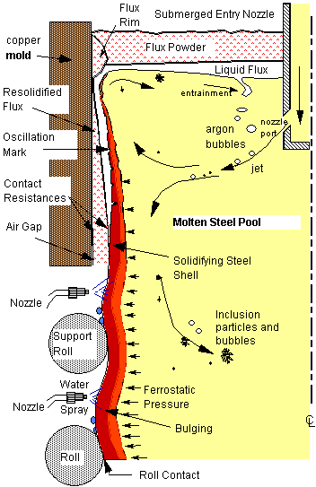
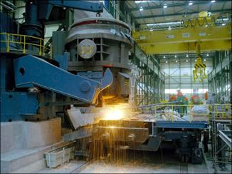
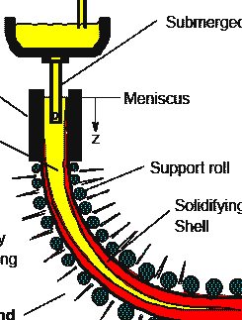
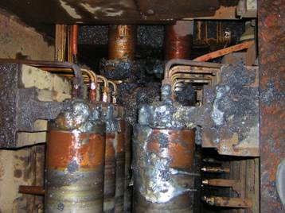

Slide 5

ONE BREAKOUT IS A LOSS OF Rs. ONE CRORE

Slide 6
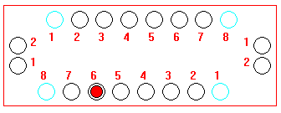
Instrumented Mold
Mould Wide
Face
Mould Narrow
Face
Thermocouple
Locations

Slide 7
Types of Breakout:
Stickers
Cracks.

Slide 8
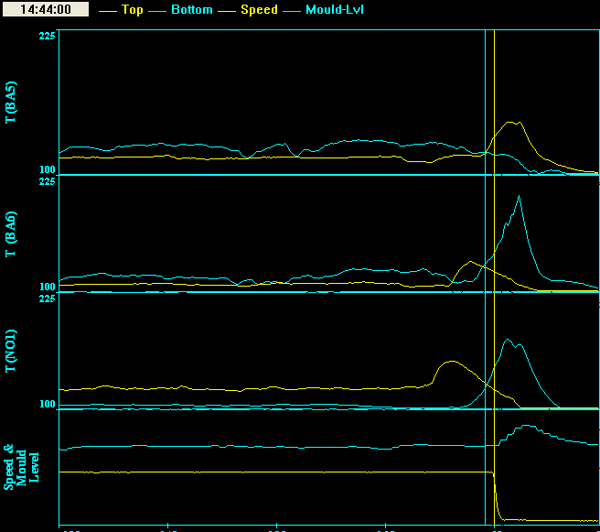
PATTERN RECOGNITION FOR FAULT PROGNOSIS :
A TYPICAL STICKER PATTERN
ID

Slide 9
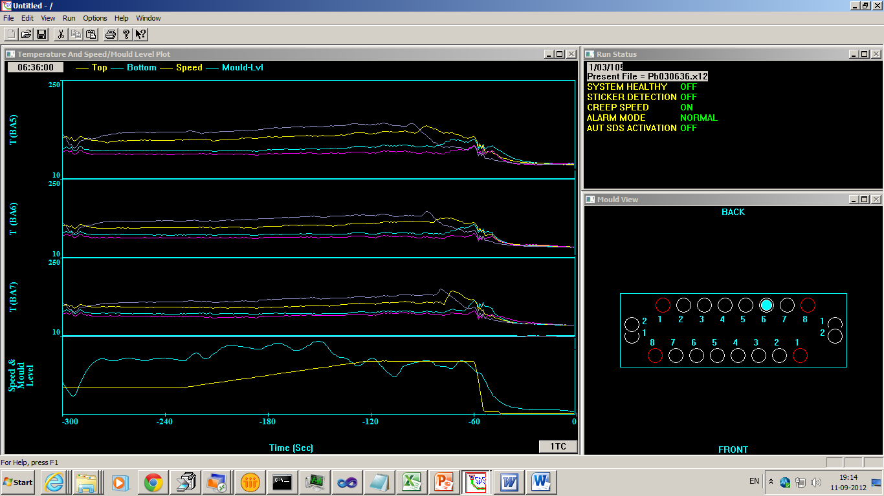

Slide 10
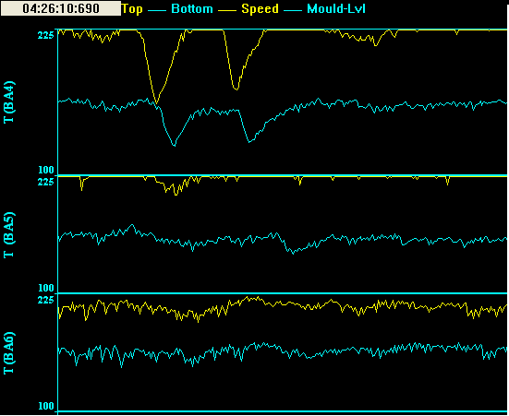
PATTERN RECOGNITION FOR FAULT PROGNOSIS :
A TYPICAL CRACK PATTERN

Slide 11
REAL-TIME FAULT PREVENTION IN STEEL MANUFACTURING: PRESENT DETECTION SYSTEMS
MOST CURRENT SYSTEMS ARE LOW-ORDER EXPERT SYSTEMS
THAT RECOGNIZE TYPICAL FAULT PATTERNS IN REAL TIME
THEY PROVIDE
ALARM ON PATTERN MATCH
NO OUTPUT OTHERWISE
IN THE PROCESS, THEY
FAIL TO CAPTURE THE INNATE CONTINUITY OF EVOLUTION OF FAULTS
IMPOSE UNDUE DETERMINISM ON A SYSTEM BASED ON KNOWLEDGE OF PROCESS DYNAMICS THAT IS INCOMPLETE AND UNCERTAIN, RISKING SERIOUS ERRORS

Slide 12
Why Fuzzy Systems in BDS?
Breakout Process
b = f(v₁, v₂, v₃,……, v_{n})
b is the chance of breakout, or ‘breakoutability’, at a layer under conditions
v₁ = vertical location, v₂ = casting speed, v₃ = temp, v₄ = rate of change of temp, etc……
Is the resultant b naturally/mathematically always a crisp binary 0 or 1?
Or is it a real number in the continuous interval [0, 1]?
How justified are we in forcibly converting the latter to the former?
⇒ It is more reasonable to deal with likelihoods of breakout than with yes/no breakout.

Slide 13
Why Fuzzy Systems in BDS?
What we seek to do in a BDS
Is the function f in b = f(v₁, v₂, v₃,……, v_{n}) precisely known?
Is there an established mathematical relationship between v_{i}, i=1,…,n and b?
NO
What we have instead is some knowledge on the effect or manifestation of this relationship; in the form
if v₁ ∈ [V₁^{B}, V₁E], …, v_{i} ∈ [V_{i}^{B}, V_{i}^{E}], …; then b ∈ [B^{B}, B^{E}].
Our entire effort in creating a BDS is to reconstruct the function f from this form of knowledge.
What is the best way to do it?

Slide 14
Why Fuzzy Systems in BDS
What is the Best way to do it?
Features of our knowledge of breakout processes:
it is continuous and not a binary step function
it is imprecise and expressed in terms of sets rather than crisp values
What is the technique/system that can encapsulate and express the imprecision & ‘bandedness’ of our knowledge?
Fuzzy systems are exactly the technique that fits this requirement
all crisp inputs are converted into ‘degrees of membership’ to predefined sets for each input/output variable : fuzzification
the input sets are combined according to combinatorial rules to yield output sets as:
if i₁ ∈ I1_{x} and i₂ ∈ I2_{Y} then o₁ ∈ O1_{Z} : note similarity with our knowledge base
the output sets fired by the rules are converted to crisp output based on the ‘degrees of activation’ of the firing rules : defuzzification
⇒ The form of our knowledge of the breakout process naturally lends itself to ready mapping into fuzzy combinatorial rules within a fuzzy system.

Slide 15
What are the inputs?
What are the outputs?
Refer to previous example.
Input 1 is rate of rise of temperature, or the slope
Input 2 is the difference between the instantaneous temperature and the baseline (plateau) temperature.

Slide 16
REAL-TIME FAULT PREVENTION IN STEEL MANUFACTURING: FUZZY MEMBERSHIP FUNCTIONS
1
MF’s for 1st & 2nd normalized inputs to sticker module, namely, temperature rise and rate of rise
0
-1 -.66 -.33 0 .15 .33 .45 .75 1
1
MF’s for normalized output breakoutability, common to all modules
0
-1 -.5 0 .2 .4 .5 .6 .7 .8 .9 1

Slide 17
Real-time Diagnostics Features
IS MORE THAN JUST A BDS – SERVES AS A
CASTING ONLINE DIAGNOSTIC SYSTEM or CODS
TELLS WHAT IS “MOST WRONG” AT EVERY INSTANT IN THE SLAB
TELLS HOW MUCH WRONG IS “MOST WRONG” – THE “BREAKOUTABILITY”
TELLS WHERE IN THE SLAB IT IS LOCATED
SHOWS ITS EVOLUTION WITH TIME RELATIVE TO MOULD (LOCATION, SPREAD, INTENSITY vs. TIME) - GRAPHICALLY, NUMERICALLY AND LITERALLY

Slide 18
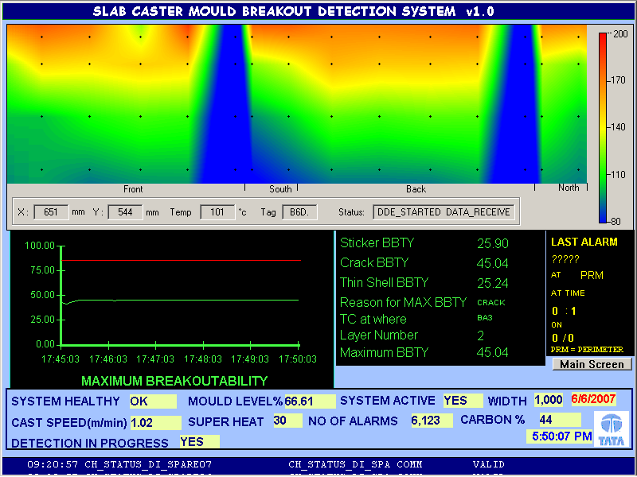

Slide 19
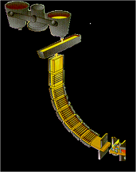
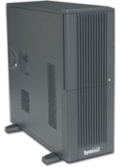

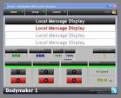
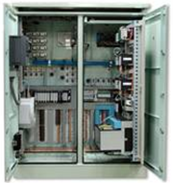


Architecture of BDS system
Plant
RAID-5 Servers, Primary and secondary
WinCC HMI
Data
to
Level 1
PLC
Redundant PLC
Development PC
Existing Process
network Switch

Slide 20
THANK YOU

Slide 21
THE CURRENT BDS/CODS - METHODOLOGY
FUZZY PARALLEL
MODULES
THERMOCOUPLES
BRK-
VALUE
STICKER
BREAKOUT-
ABILITY
ANALYZER
BRK-
TYPE
CRACK
THIN-
SHELL
BRK-
LOCATION
OUTPUTS
INPUTS
INTELLIGENT
AGENT

